Slide 1
Ticket Reservation System
of WAINS TRANSPORT

Slide 2
Submitted to Dr. Humaira Afzal
Submitted By Talha Sajid Chaudhary
MCSE-19-35 2019-2021

Slide 3
Overview
Introduction
System Analysis
System Design
System Development and Implementation
User Guide

Slide 4
Introduction
The Bus Management System of WAINS Transport is a web-based application that Allows Visitors to Check Bus Ticket Availability and Reserve Bus Ticket Online. This System Provides a Facility to reserve seats, Cancelling Reservation. Bus Management System of Wains Transport Deals with the Maintenance of the record of each Passenger who has Reserved a Seat for Journey. It also Includes Maintenance of Information like Schedule and Details of each Bus.
This Project of Bus Management System of WAINS Transport is to Improve the Productivity of Company's Employees with the Objectives to Manage the Data on Every Bus Terminal and Make a website to Reserve Seats and Check the Travel Fares.

Slide 5
System Analysis

Slide 6
System Design
Online Bus Ticket Reservation System has two Modules
Administrative Module
User Module
This System has Two Types of Users
Admin
User

Slide 7
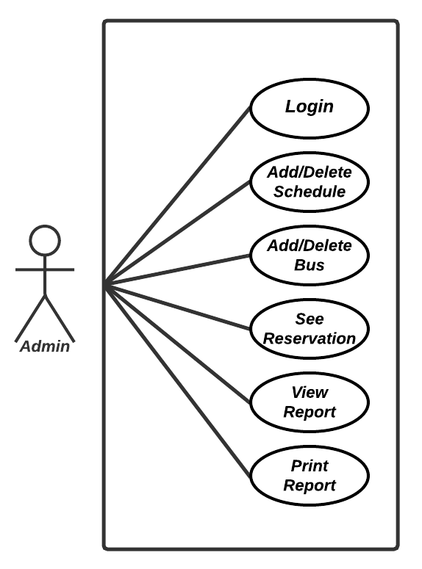
System Design
Use Case Diagram of Admin
It will show what Admin can do in this System

Slide 8
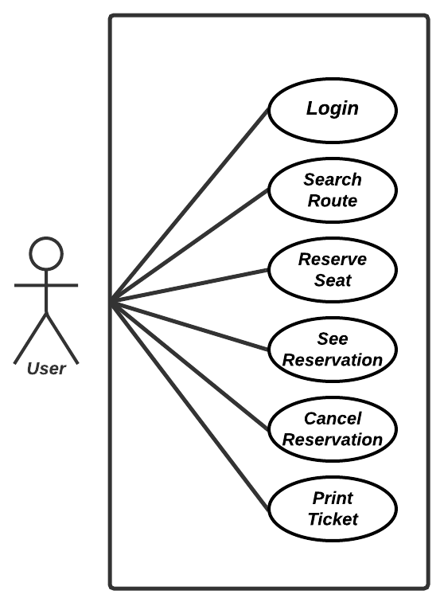
System Design
Use Case Diagram of User
It will show what User can do in this System

Slide 9
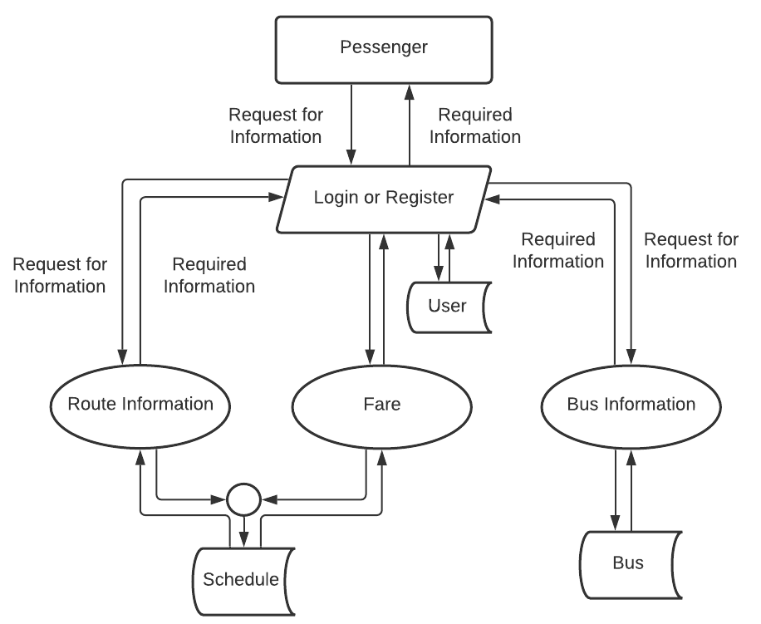
System Design
General DFD
The General Data Flow Diagram of the System is as Follow

Slide 10
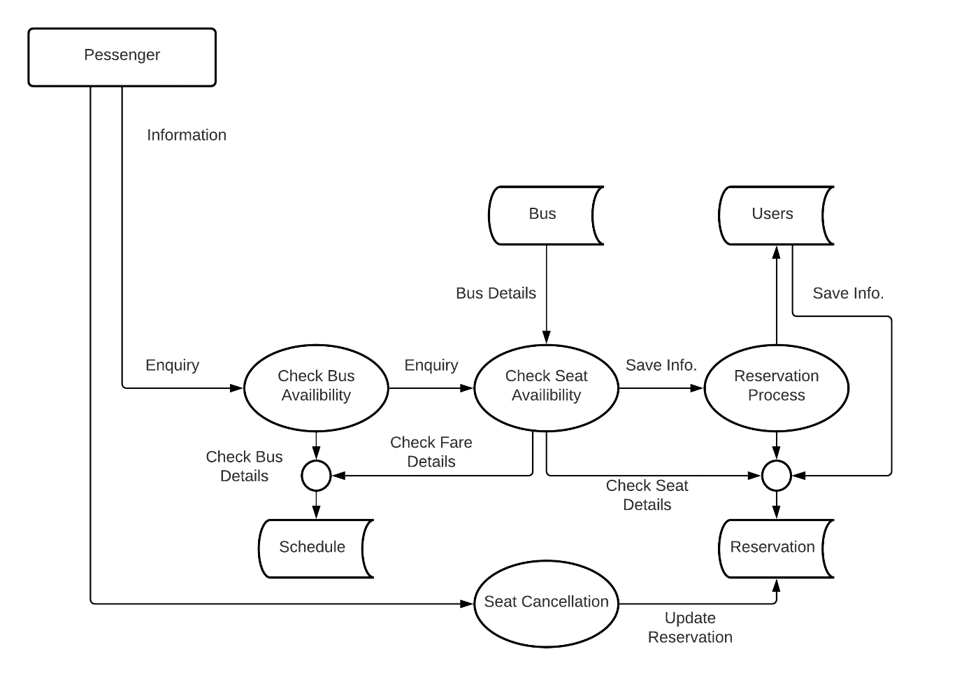
System Design
DFD of Reservation

Slide 11
System Design
Sequence Diagram
It is the sequence diagram of the user making reservation on the System online and Printing the Ticket afterward.

Slide 12
System Development and Implementation
Tools and Languages Used during the Development of the System are as follow
PHP
HTML
CSS
JavaScript
jQuery

Slide 13
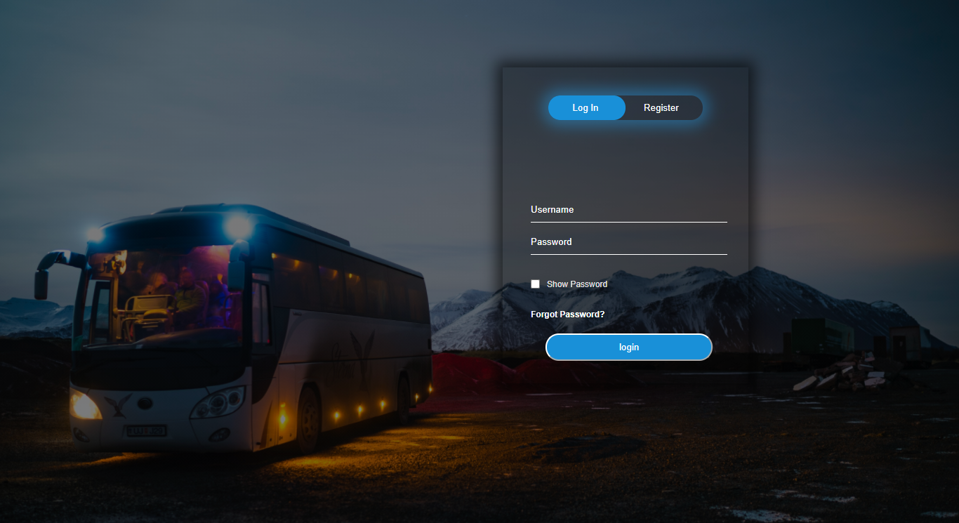
User’s Guide
Login Form

Slide 14
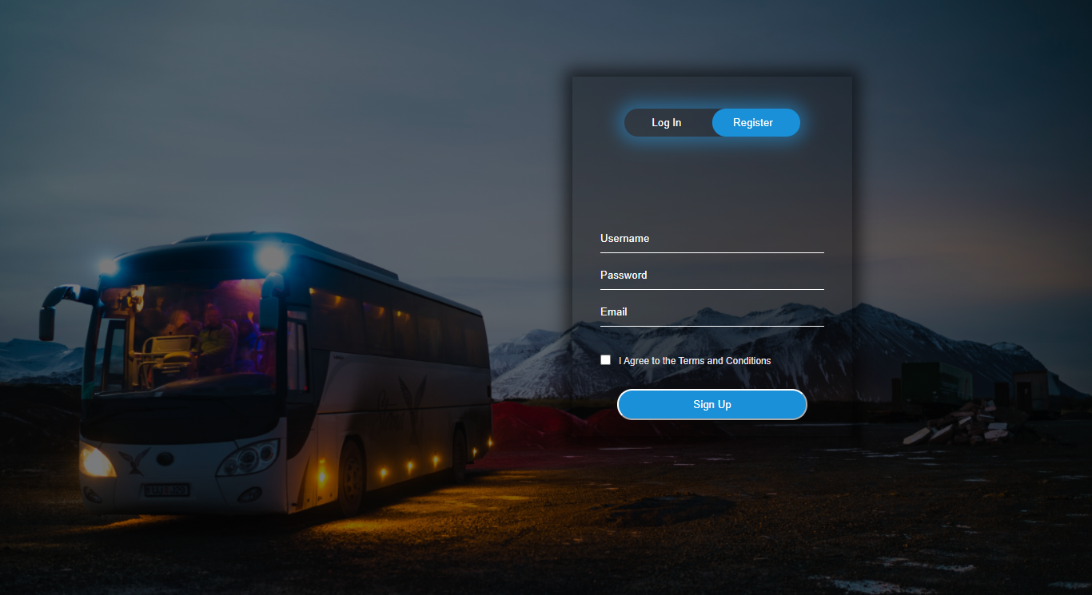
User’s Guide
Registration Form

Slide 15
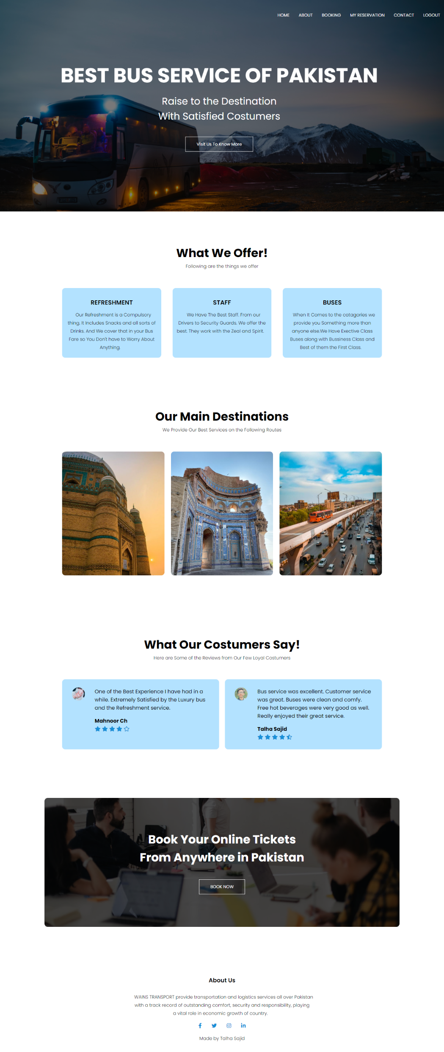
User’s Guide
Home Page

Slide 16
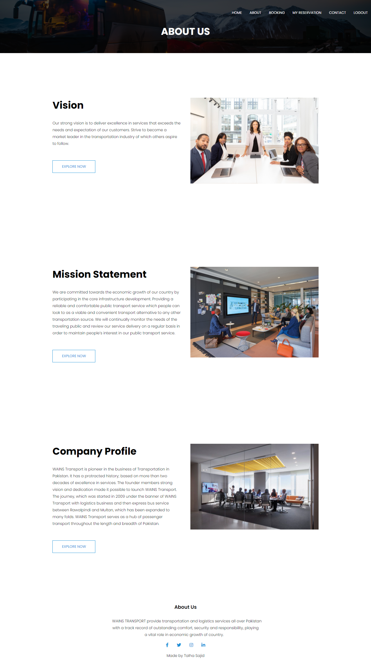
User’s Guide
About Page

Slide 17
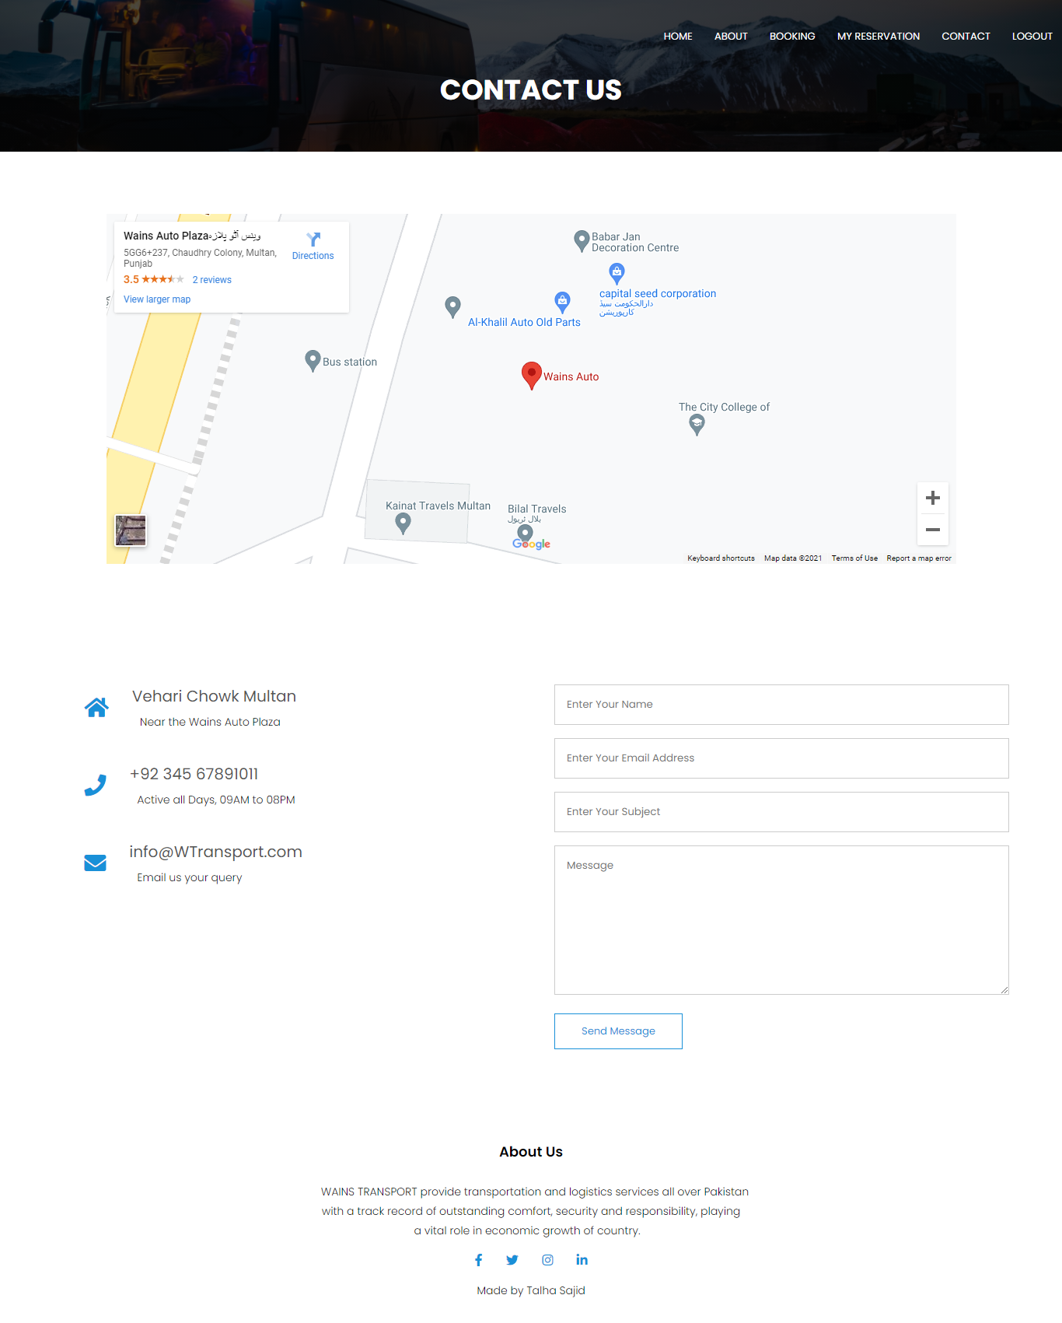
User’s Guide
Contact Page

Slide 18
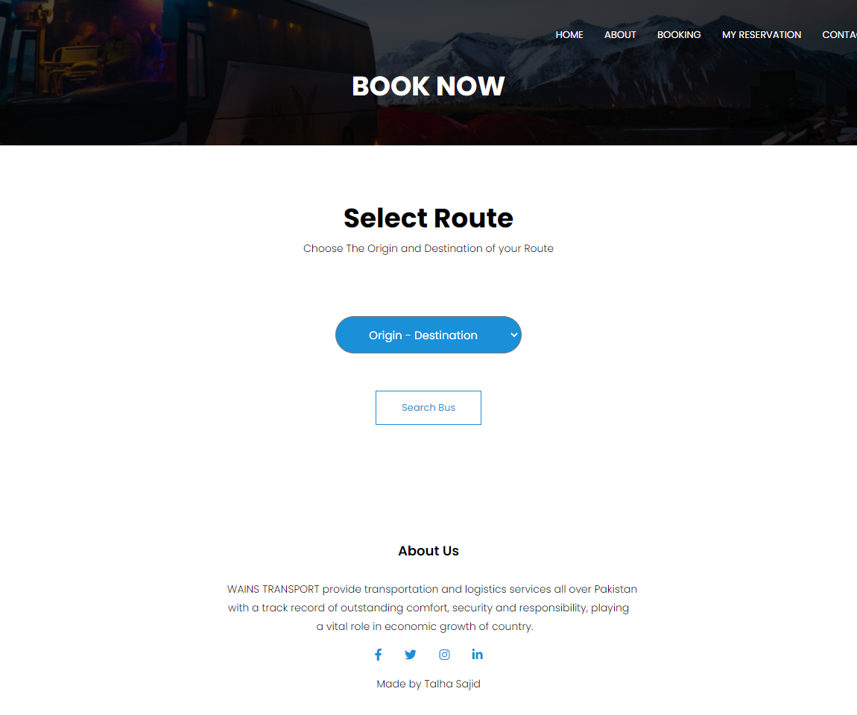
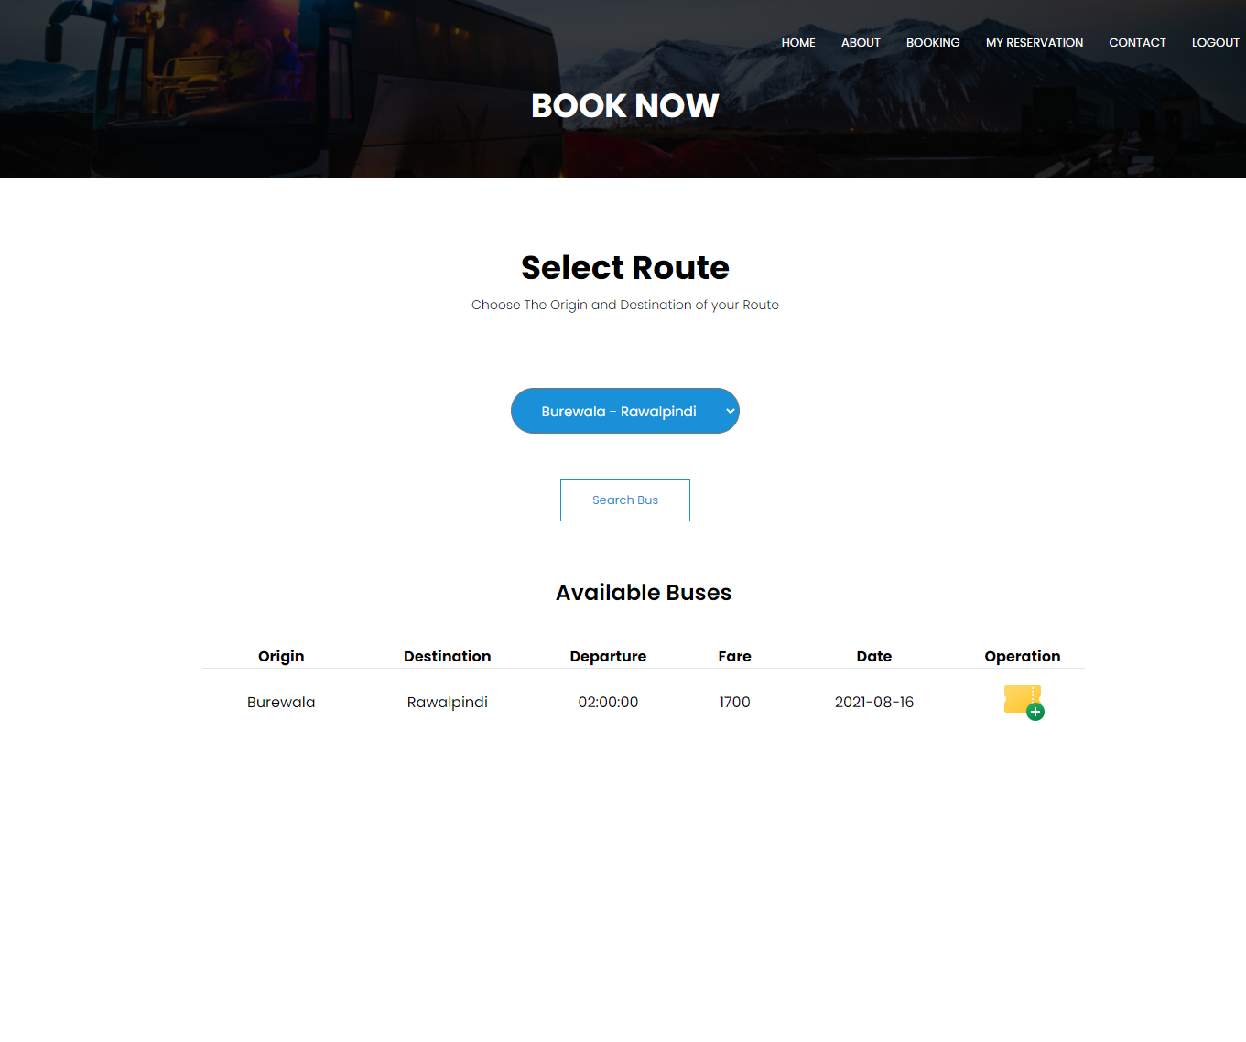
User’s Guide
Booking Page

Slide 19
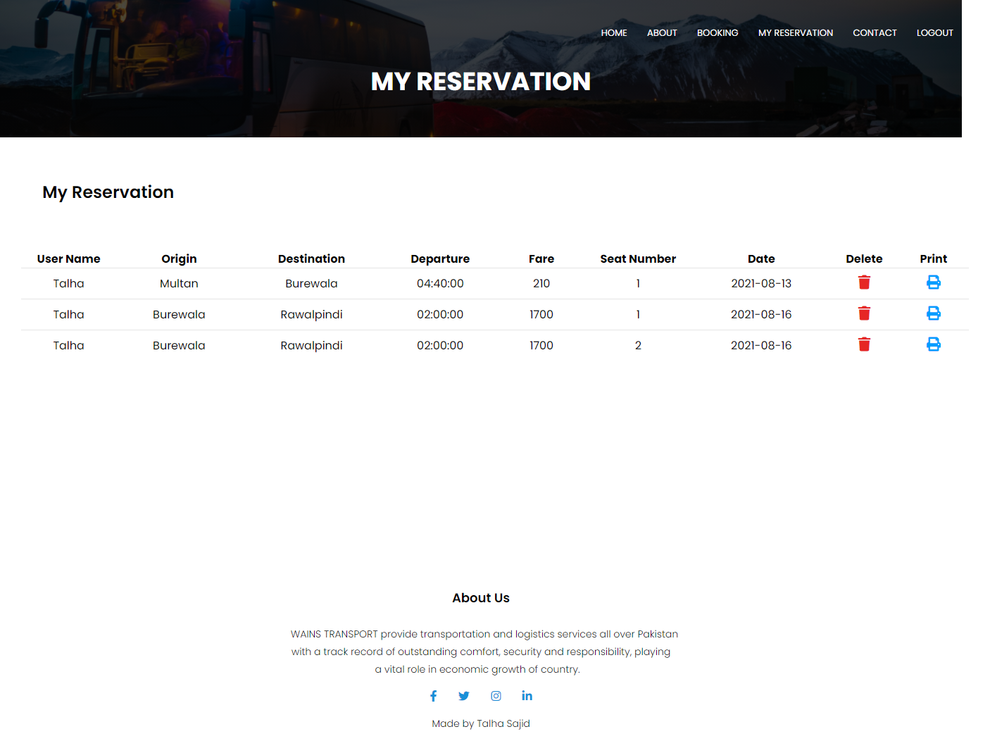
User’s Guide
My Reservation Page

Slide 20
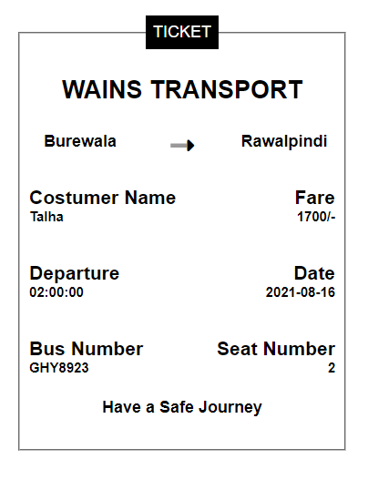
User’s Guide
Printed Ticket

Slide 21
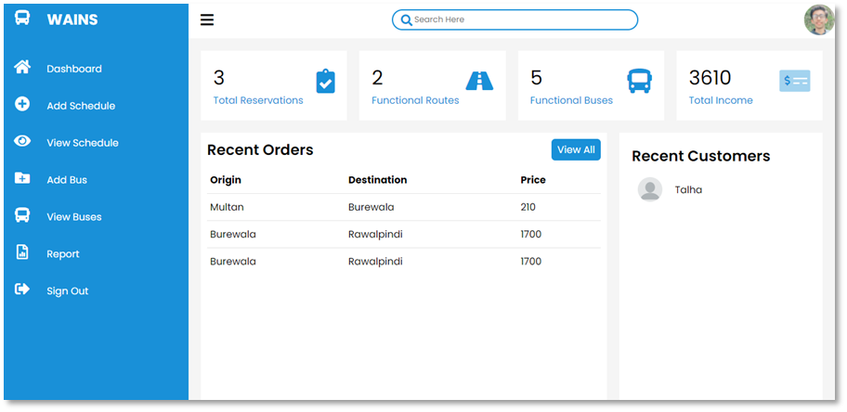
User’s Guide
Admin Dashboard

Slide 22
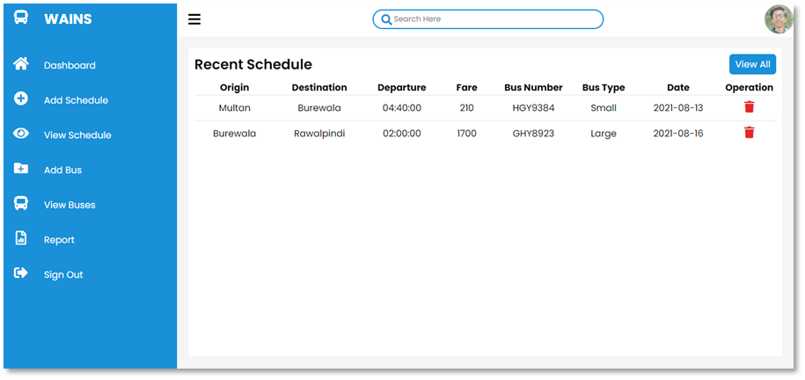
User’s Guide
Admin View Schedule Page

Slide 23
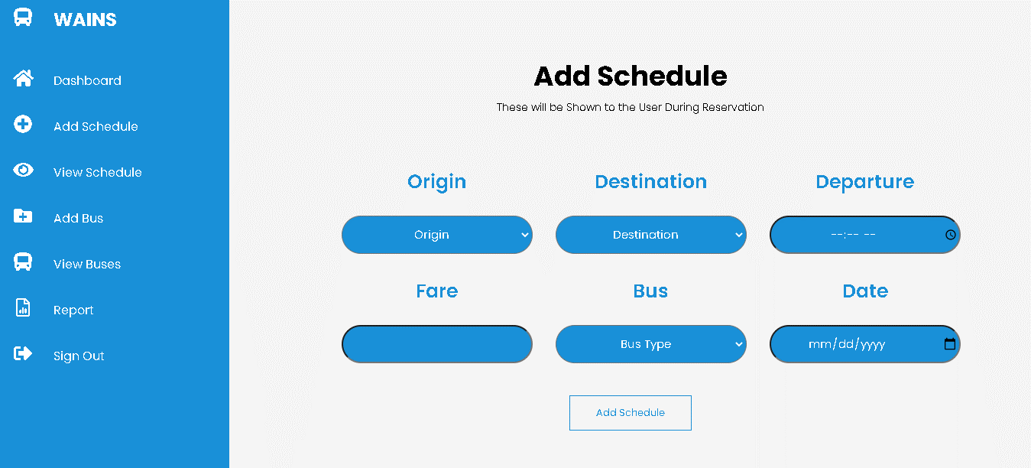
User’s Guide
Admin Add Schedule Page

Slide 24
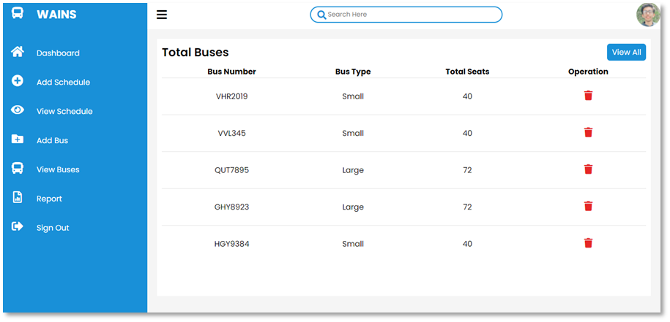
User’s Guide
Admin View Buses Page

Slide 25
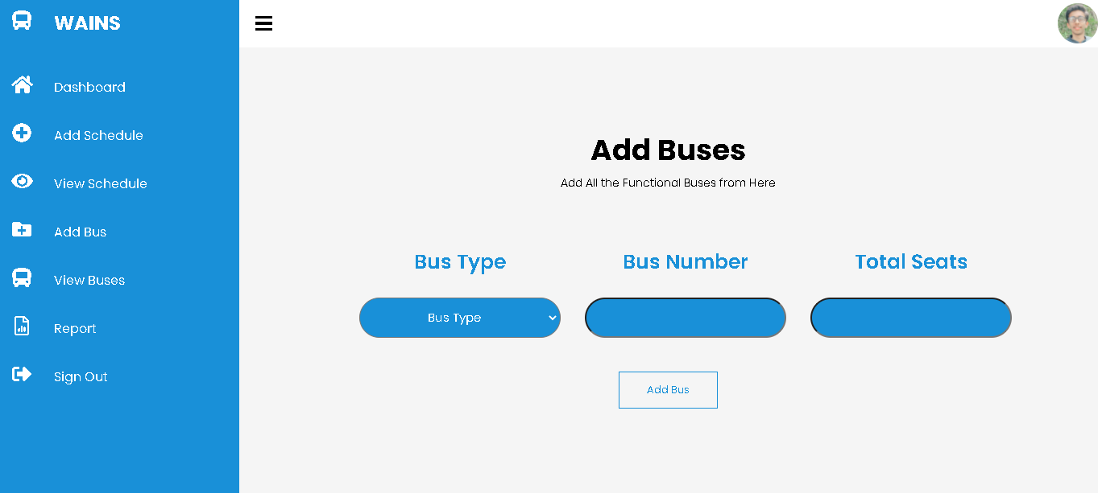
User’s Guide
Admin Add Buses Page

Slide 26
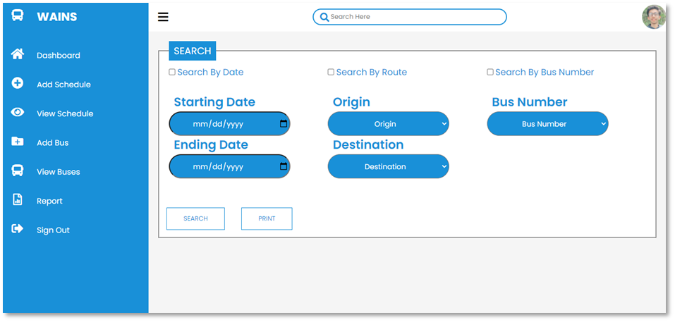
User’s Guide
Report

Slide 27
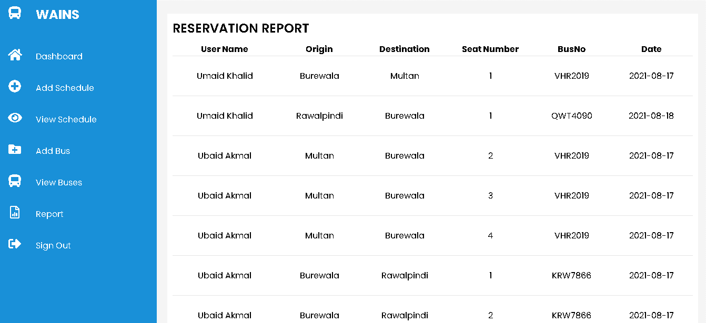
User’s Guide
Report After applying the Search Filters

Slide 28
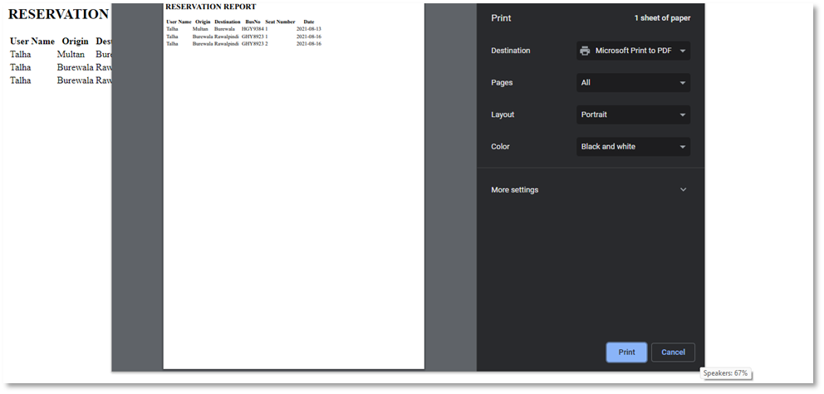
User’s Guide
Printing the Report

Slide 29
Thanks For Your Time

